Slide 1
Probability and Statistical Inference
Describing and Presenting Data
Sources used in creation of this lecture:
Statistics and Data Analysis, Peck, Olsen and Devore; Discovering Statistics Using IBM SPSS (equivalent R book) , Andy Field; Understanding Basic Statistics, Brase and Brase

Slide 2
Basics of Statistics
Science of collection, presentation, analysis, and reasonable interpretation of data.
Statistics provides a rigorous scientific method for gaining insight into data.

Slide 3
Experiments and Variables
For our purposes a statistical experiment or observation is any process through which measurements are obtained
Common to use the letter x to represent the quantitative results of an experiment or observation
X is a variable, x is the value of the variable

Slide 4
Random Variables
A variable is considered a random variable if the value it takes on in a given experiment or observation is determined by chance
A variable whose realization is determined by chance
A discrete random variable
May only take on a finite number of values or countable number of values
Result of a count
A continuous random variable
May take on any number of values in a line interval
Measured on a continuous scale

Slide 5
Variables
Not only something we measure
Others we measure indirectly
There will sometimes be a difference between the numbers we use to represent a thing we are measuring and the actual value of the thing (if we were measuring it directly)
Measurement error
E.g. psychological tests are approximate measures

Slide 6
Variables
May be
Things we can manipulate
Compute
Or control for

Slide 7
Study Design
A careful advance plan of data collection and the analytic approach is needed to answer the question under investigation in a scientific way.
The basic elements of a study design
Selecting an appropriate sample size for a specified level of power and level of significance
Select appropriate measures
Selecting methods of sampling, data collection, and analysis appropriate to the study's objectives

Slide 8
Guidelines for Presenting Descriptive Statistics
Ensure that you are using the most appropriate way of summarizing and presenting your data
Be as efficient as possible when presenting your findings.
All charts and tables should, as far as possible, be self-explanatory.
Use appropriate visualisation for the variables of interest
Be consistent in the way you present your findings.
Ensure that your data are not presented in a way that may be misleading and/or confusing.

Slide 9
What do I need to describe for numerical data?
Centre
Discuss where the middle of the data falls
Measures of central tendency
mean, median and mode
Spread
Discuss how spread out the data is
Refers to the variability in the data
Range, standard deviation, IQR
Shape
Refers to the overall shape of the distribution
Symmetrical, uniform, skewed, or bimodal

Slide 10
What do I need to describe for numerical data?
Unusual Occurrences
Outliers (value that lies away from the rest of the data)
Gaps
Clusters
Context
You must write your answer in reference to the context in the problem, using correct statistical vocabulary and using complete sentences.

Slide 11
Methods of centre Measurement
Mean
Summing up all the observation and dividing by number of observations.
Median
The middle value in an ordered sequence of observations. That is, to find the median we need to order the data set and then find the middle value.
In case of an even number of observations the average of the two middle most values is the median.
Mode
The value that is observed most frequently.
Undefined for sequences in which no observation is repeated.

Slide 12
Mean or Median
The median is less sensitive to outliers (extreme scores) than the mean and thus a better measure than the mean for highly skewed distributions, e.g. family income.
Example
Mean of 20, 30, 40, and 990 is (20+30+40+990)/4 =270.
Median of these four observations is (30+40)/2 =35.
3 observations out of 4 lie between 20-40.
Mean of 270 really fails to give a realistic picture of the major part of the data.
It is influenced by extreme value 990.
Median is more reflective of the data.

Slide 13

Population characteristic
Suppose we want to know the MEAN length of all the fish in Lough Mask . . .
Fixed value about a population typically unknown
Is this a value that is known?
Can we find it out?
At any given point in time, how many values are there for the mean length of fish in the lake?

Slide 14
Statistic
Suppose we want to know the MEAN length of all the fish in Lough Mask.
What can we do to estimate this unknown population characteristic?
Value calculated from a sample

Slide 15
Review
In a symmetrical distribution, the mean and median are equal.
In a symmetrical distribution, you should report the mean
In a skewed distribution, the mean is pulled in the direction of the skewness.
In a skewed distribution, you should report the median

Slide 16
Trimmed mean:
Purpose is to remove outliers from a data set
To calculate a trimmed mean:
Multiply the percent to trim by n (number in the sample)
Truncate that many observations from BOTH ends of the distribution (when listed in order)
Calculate the mean with the shortened data set
Not often used for large datasets
Example Olympic Diving/Gymnastics scoring
Used to eliminate extreme scores/bias from judges

Slide 17
Find the mean of the following set of data.
12 14 19 20 22 24 25 26 26 50
Find a 10% trimmed.
Mean = 23.8
10%(10) = 1
So remove one observation from each side!

Slide 18

Why is the study of variability important?
Variability (or dispersion) measures the amount of scatter in a dataset.
There is variability in virtually everything
Allows us to distinguish between usual and unusual values
Reporting only a measure of centre doesn’t provide a complete picture of the distribution.
Does this can of cola contain exactly 330 ml?

Slide 19
Types of Variation
Systematic Variation
Differences in performance created by a specific experimental manipulation.
Unsystematic Variation
Differences in performance created by unknown factors.
Age, gender, IQ, time of day, measurement error, etc.
Randomization
Minimizes unsystematic variation.

Slide 20
Notice that these three data sets all have the same mean and median (at 45), but they have very different amounts of variability.

Slide 21
Methods of Variability/Dispersion Measurement
Commonly used methods:
Range, variance, standard deviation, interquartile range, coefficient of variation etc.

Slide 22
Measures of Variability
The simplest numeric measure of variability is range.
Its a crude measure of variability.
Range = largest observation – smallest observation
The first two data sets have a range of 50 (70-20) but the third data set has a much smaller range of 10.

Slide 23
Measures of Variability
Another measure of the variability in a data set uses the deviations from the mean (x – x).
Can we find an average deviation?
What can we do to the deviations so that we could find an average?
A sample of 6 fish that we caught from the lake . . .
They were the following lengths:
3”, 4”, 5”, 6”, 8”, 10”
The mean length was 6 inches. We can calculate the deviations from the mean. What was the sum of these deviations?
Population variance is denoted by s².
The estimated average of the deviations squared is called the variance.
Degree of freedom

Slide 24
Remember the sample of 6 fish that we caught from the lake . . .
Find the variance of the length of fish.
First square the deviations
x | (x - x) | (x - x)²
3 | -3
4 | -2
5 | -1
6 | 0
8 | 2
10 | 4
Sum | 0
Finding the average of the deviations would always equal 0 (in a symmetrical distribution)!
9
4
1
What is the sum of the deviations squared?
0
4
Divide this by 5.
Standard Deviation
16
34
s² = 6.8

Slide 25
Measures of Variability
The square root of variance is called standard deviation.
A typical deviation from the mean is the standard deviation.
Our fish example: s² = 6.8 inches² so s = 2.608 inches
The fish in our sample deviate from the mean of 6 by an average of 2.608 inches.

Slide 26
Suppose that everyone in the class caught a sample of 6 fish from the lake. Would each of our samples contain the same fish?
Would our mean lengths be the same?
The samples would also have different ranges!
When calculating sample variance, we use degrees of freedom (n – 1) in the denominator instead of n because this tends to produce better estimates.
Notes:
See page 189 for more information.

Slide 27
Degrees of freedom
Degrees of freedom of an estimate is the number of independent pieces of information that went into calculating the estimate.
It’s not quite the same as the number of items in the sample.
In order to get the df for the estimate, you have to subtract 1 from the number of items.
Why do we subtract 1 from the number of items?
Another way to look at degrees of freedom is that they are the number of values that are free to vary in a data set.
Or the number of values that need to be known in order to know all the values needed to achieve a particular value.

Slide 28
Degrees of freedom
What does “free to vary” mean?
An example using the mean:
Pick a set of numbers that have a mean of 10.
Some sets of numbers you might pick: 9, 10, 11 or 8, 10, 12 or 5, 10, 15.
Once you have chosen the first two numbers in the set, the third is fixed.
In other words, you can’t choose the third item in the set.
The only numbers that are free to vary are the first two.
You can pick 9 + 10 or 5 + 15, but once you’ve made that decision you must choose a particular number that will give you the mean you are looking for.
So degrees of freedom for a set of three numbers is TWO (n-1).

Slide 29
Degrees of freedom
Two Samples
If you have two samples and want to find a parameter, like the mean, you have two “N”s to consider (sample 1(N₁) and sample 2(N₂)).
Degrees of freedom in that case is: (N₁ + N₂) – 2.

Slide 30
Measures of Variability
Interquartile range (IQR) is the range of the middle half of the data.
Lower quartile (Q1) is the median of the lower half of the data
Upper quartile (Q3) is the median of the upper half of the data
iqr = Q3 – Q1
What advantage does the interquartile range have over the standard deviation?
The IQR is resistant to extreme values

Slide 31
The Chronicle of Higher Education (2009-2010 issue) published the accompanying data on the percentage of the population with a bachelor’s or higher degree in 2007 for each of the 50 states and the District of Columbia.
21 27 26 19 30 35 35 26 47 26 27 30 24 29 22 24 29 20 20 27 35 38 25 31 19 24 27 27 23 34 25 32 26 24 22 28 26 30 23 25 22 25 29 33 34 30 17 25 23 34 26
Find the interquartile range for this set of data.

Slide 32
21 27 26 19 30 35 35 26 47 26 27 30 24 29 22 24 29 20 20 27 35 38 25 31 19 24 27 27 23 34 25 32 26 24 22 28 26 30 23 25 22 25 29 33 34 30 17 25 23 34 26
17 19 19 20 20 21 22 22 22 23 23 23 24 24 24 24 25 25 25 25 25 26 26 26 26 26 26 27 27 27 27 27 28 29 29 29 30 30 30 30 31 32 33 34 34 34 35 35 35 38 47
24
26
30
First put the data in order & find the median.
Find the upper quartile (Q₃) by finding the median of the upper half.
Find the lower quartile (Q₁) by finding the median of the lower half.
iqr = 30 – 24 = 6

Slide 33
Which Descriptive Statistic to use?
Depends on measurement type and data dispersion
Interval or Ratio (Scale)
Normally distributed
Mean and Standard Deviation
Skewed
Median and Interquartile Range
Ordinal or nominal
Mode and/or simple frequencies
KEY SLIDE

Slide 34
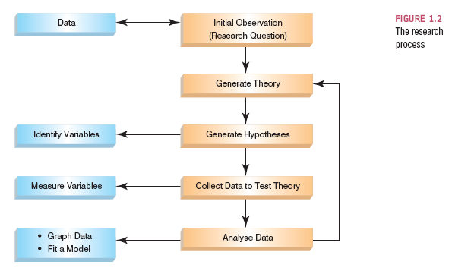
The Research Process

Slide 35
Analysing Data
First step: Graph the data
Frequency Distributions (aka Histograms)
A graph plotting values of observations on the horizontal axis, with a bar showing how many times each value occurred in the data set.
Ideal: The ‘Normal’ Distribution
Bell-shaped
Symmetrical around the centre

Slide 36
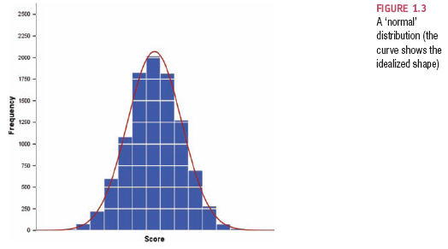
The Normal Distribution

Slide 37
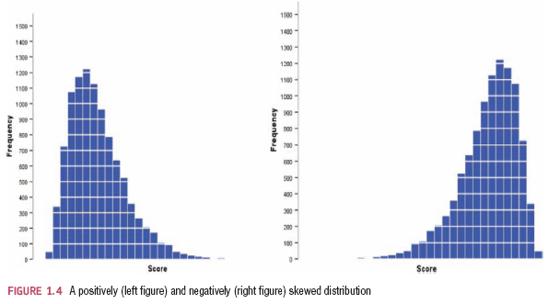
Skew

Slide 38
Properties of Frequency Distributions
Skew
The symmetry of the distribution.
Positive skew (scores bunched at low values with the tail pointing to high values).
Negative skew (scores bunched at high values with the tail pointing to low values).
Kurtosis
The ‘heaviness’ of the tails.
Leptokurtic = heavy tails (more scores in the tails).
Platykurtic = light tails (more scores in the middle).

Slide 39
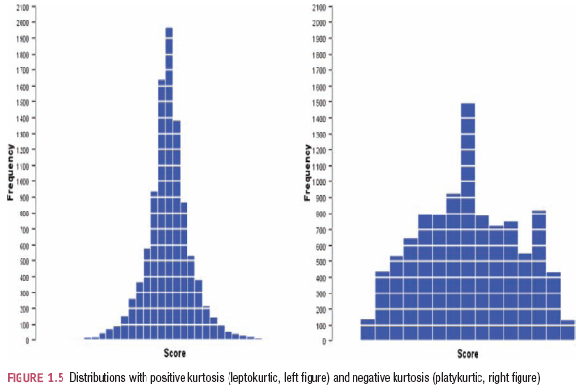
Kurtosis

Slide 40
Going beyond the data

Slide 41
Frequency Distribution
Not only useful for descriptive purposes
Can be used to calculate likelihood of particular values occurring – probability
For any distribution we could calculate the probability of achieving any of the possible values
Tedious, time consuming
Statisticians have created a range of idealized distributions probability distributions and from these we can calculate the likelihood of achieving particular values if our data distribution matches

Slide 42
Probability
Chance behaviour is unpredictable in the short term, but has a regular and predictable pattern in the long term.
The probability of any outcome of a random phenomenon is the proportion of times the outcome would occur in a very long series of repetitions.
Sample Space
The set of all possible outcomes of a random phenomenon
Event
Any set of outcomes of interest
Probability of an event
The relative frequency of this set of outcomes over an infinite number of trials
P(A) is the probability of event A

Slide 43
Probability Distributions
X represents the random variable X.
P(X) represents the probability of X.
P(X = x) refers to the probability that the discrete random variable X is equal to a particular value, denoted by x.
As an example, P(X = 1) refers to the probability that the random variable X is equal to 1.
Cumulative probability is the probability that a value falls within a particular range or interval
P(X<=x)

Slide 44
Probability Distributions
The probability distribution for a random variable X gives the possible values for X, and the probabilities associated with each possible value (i.e., the likelihood that the values will occur)
Has a probability assigned to each distinct value of the variable
A cumulative probability refers to the probability that the value of a random variable falls within a specified range.
The methods used to specify discrete probability distributions are similar to (but slightly different from) those used to specify continuous probability distributions

Slide 45
Discrete Random Variable
Has a probability assigned to each distinct value of the variable
The sum of all assigned probabilities must be 1
Probability distribution can be considered a relative-frequency distribution and therefore has a mean and standard deviation
Mean is often called the expected value
Represents a cluster point for the entire distribution
Need not be an actual value of a point of the sample space
Standard deviation is represented as a measure of risk
Larger the standard deviation, the more likely it is that a random variable x is different from the expected value

Slide 46
Discrete Probability Distribution
Shows us the complete space on which the distribution is based
The corresponding probability of each event in the sample space

Slide 47
Probability Distributions
Suppose you flip a coin two times.
This simple statistical experiment can have four possible outcomes:
HH (two heads), HT (heads and tails), TH (tails and heads), and TT.(tails and tails)
Let the variable X represent the number of Heads that result from this experiment.
X can take on the values 0, 1, or 2.
In this example, X is a random variable because its value is determined by the outcome of a statistical experiment.

Slide 48
Probability Distribution
A probability distribution is a table or an equation that links each outcome of a statistical experiment with its probability of occurrence.
Number of heads(X) | Probability
0 | 0.25
1 | 0.50
2 | 0.25
Probability of X=the number of Heads that result from this experiment

Slide 49
Probability Distributions
A cumulative probability refers to the probability that the value of a random variable falls within a specified range.
This can be represented by a table or an equation which refers to the probability than the random variable X is less than or equal to x.
If we flip a coin two times, what is the probability that the coin flips would result in one or fewer heads?
The answer would be a cumulative probability.
It would be the probability that the coin flip experiment results in zero heads plus the probability that the experiment results in one head.
P(X < 1) = P(X = 0) + P(X = 1) = 0.25 + 0.50 = 0.75

Slide 50
Probability Distribution
Number of heads: | Probability: P(X = x) | Cumulative Probability: P(X < x)
0 | 0.25 | 0.25
1 | 0.50 | 0.75
2 | 0.25 | 1.00

Slide 51
Probability Distribution
The simplest probability distribution occurs when all of the values of a random variable occur with equal probability.
This probability distribution is called the uniform distribution.
Suppose the random variable X can assume k different values.
Suppose also that the P(X = x_{k}) is constant. Then,P(X = x_{k}) = 1/k
Suppose a die is tossed.
What is the probability that the die will land on 5 ?
There are 6 possible outcomes represented by: S = { 1, 2, 3, 4, 5, 6 }.
Each possible outcome is a random variable (X), and each outcome is equally likely to occur.
Thus, we have a uniform distribution. Therefore, the P(X = 5) = 1/6.

Slide 52
Probability Distribution
Suppose we undertake a dice tossing experiment
This time, we ask what is the probability that the die will land on a number that is smaller than 5 ?
There are still 6 possible outcomes represented by: S = { 1, 2, 3, 4, 5, 6 }.
This problem involves a cumulative probability.
The probability that the die will land on a number smaller than 5 is equal to:
P( X < 5 ) = P(X = 1) + P(X = 2) + P(X = 3) + P(X = 4) = 1/6 + 1/6 + 1/6 + 1/6 = 2/3

Slide 53
Continuous Probability Distribution
If a random variable is a continuous variable (variable can take on any value between two specified values), its probability distribution is called a continuous probability distribution.
A continuous probability distribution cannot be expressed in tabular form
An equation or formula (probability density function) is used.
Hypothesis testing relies extensively on the idea that, having such a function, one can compute the probability of all the corresponding events i.e. probability of a X taking a value less than or equal to a particular value (a)

Slide 54
Continuous Probability Distribution
The density function has the following properties:
Since the continuous random variable is defined over a continuous range of values (called the domain of the variable), the graph of the density function will also be continuous over that range.
The area bounded by the curve of the density function and the x-axis is equal to 1, when computed over the domain of the variable.
The probability that a random variable assumes a value between a and b is equal to the area under the density function graph bounded by a and b.

Slide 55
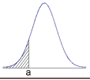
Continuous Probability Function
Consider the probability density function shown in the graph below.
Suppose we wanted to know the probability that the random variable X was less than or equal to a.
This is equal to the area under the curve bounded by a and minus infinity - as indicated by the shaded area.
The shaded area in the graph represents the probability that the random variable X is less than or equal to a.
This is a cumulative probability.

Slide 56
Calculating Probability from a Frequency distribution
Statisticians have described several common frequency distributions
For each they have created mathematical formulae (probability density functions) that specify idealized versions of these distributions
We can draw the function by plotting the value of a variable x against the probability of it occurring y which gives us the probability distribution
The area under the curve of this distribution tells us something about the probability of a value occurring
We can use the area under the curve between two values to tell us how likely it is that a score falls between these two values

Slide 57
So what does this mean for us?
Our frequency distribution gives use the opportunity to to calculate likelihood of particular values occurring – probability using relevant probability calculations
Tedious, time consuming
Statisticians have created a range of idealized distributions probability distributions and from these we can calculate the likelihood of achieving particular values if our data distribution matches

Slide 58
Standard normal
Statisticians have calculated the probability of scores occurring in a distribution with a mean of 0 and a standard deviation of 1
So what?
If we have data shaped like the normal distribution then the mean can be mapped to 0 and the standard deviation to 1
We can then use the tables of probability created by these statisticians to work out the probability of particular scores occurring within that distribution
How do we map our scores to fit the standard normal?

Slide 59
Z Scores and Raw scores
If we want to compare samples with normal distributions then mean of each may located anywhere on the x axis and the scores more/less spread out as determined by the standard deviation
This causes difficulties when calculating the area under the curve and hence the probability that a measurement will fall into the interval of interest
We could have sets of tables that calculate the area under the curve for each combination of µ and σ but this would be quite an onerous task to compile or use

Slide 60
Z Scores and Raw scores
We need a way to standardise the distributions so we can use one table for all normal distributions
We can use the standard deviation as the measurement scale
We consider how many standard deviations a measure is from the mean
This allows comparison between a value in one normal distribution with a value in another

Slide 61
Going beyond the data: Z-scores
Z-scores
Standardising a score with respect to the other scores in the group.
Expresses a score in terms of how many standard deviations it is away from the mean.
The distribution of z-scores has a mean of 0 and SD = 1.

Slide 62
z-scores
A z-score states the position of a raw score in relation to the mean of the distribution, using the standard deviation as the unit of measurement.
This is a z test
The z score is therefore a test statistic
1. Find the difference between a score and the mean of the set of scores.
2. Divide this difference by the SD (in order to assess how big it really is).

Slide 63
z-scores transform our original IQ scores into scores with a mean of 0 and an SD of 1.
Raw IQ scores (mean = 100, SD = 15)
z for 100 = (100-100) / 15 = 0, z for 115 = (115-100) / 15 = 1,
z for 70 = (70-100) / -2, etc.
raw:
55 70 85 100 115 130 145
z-score:
-3 -2 -1 0 +1 +2 +3

Slide 64
Raw score distributions V Z Score distributions
A score, X, is expressed in the original units of measurement:
X = 65
X = 236
z = 1.5
z-score distribution:
X is expressed in terms of its deviation from the mean (in SDs).
So plotting the z scores we are plotting the test statistic

Slide 65
The Standard Normal Distribution
The distribution of a normal variable with mean equal to zero and standard deviation equal to 1.
Looks identical to that of the normal but uses a different measurement scale.
So what?
It is the fact that we can now have a table showing, for each point in [−∞, +∞], the probability that we have a realization of a variable to the left and to the right of that point.

Slide 66
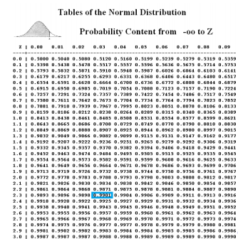
The probability that a realization is lower than point 2.33 = 0.99
Then the probability that the realization is above 2.33 (1-0.99) = 0.01

Slide 67
Why use z-scores?
z-scores make it easier to compare scores from distributions using different scales.
e.g. two tests:
Test A: Fred scores 78. Mean score = 70, SD = 8.
Test B: Fred scores 78. Mean score = 66, SD = 6.
Did Fred do better or worse in comparison to the rest of the class on the second test?

Slide 68
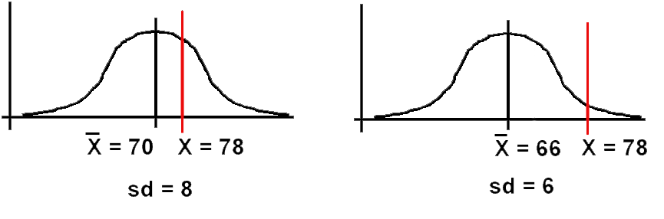
Test A: as a z-score, z = (78-70) / 8 = 1.00
Test B: as a z-score , z = (78 - 66) / 6 = 2.00
Conclusion: Fred comparatively did much better on Test B.

Slide 69
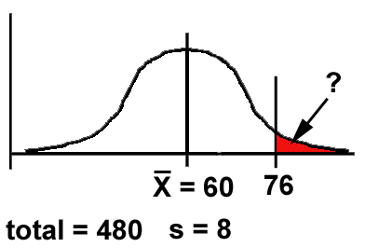
z-scores enable us to determine the relationship between one score and the rest of the scores, using just one table for all normal distributions.
If we have 480 scores, normally distributed with a mean of 60 and an SD of 8, how many would be 76 or above?
Graph the problem:

Slide 70
Work out the z-score for 76:
z = (X - X) / s = (76 - 60) / 8 = 16 / 8 = 2.00
We need to know the size of the area beyond z (remember - the area under the Normal curve corresponds directly to the proportion of scores).

Slide 71
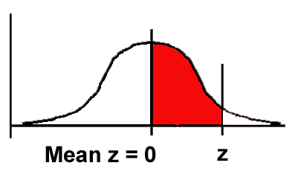
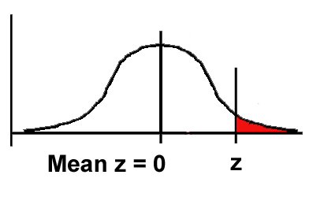
Many statistics books have z-score tables, giving us this information:
z | (a) Area between mean and z | (b) Area beyond z
0.00 | 0.0000 | 0.5000
0.01 | 0.0040 | 0.4960
0.02 | 0.0080 | 0.4920
: | : | :
1.00 | 0.3413 | 0.1587
: | : | :
2.00 | 0.4772 | 0.0228
: | : | :
3.00 | 0.4987 | 0.0013
(a)
(b)

Slide 72
0.0228
So: as a proportion of 1, 0.0228 of scores are likely to be 76 or more.
As a percentage, = 2.28%
As a number, 0.0228 * 480 = 10.94 scores.

Slide 73
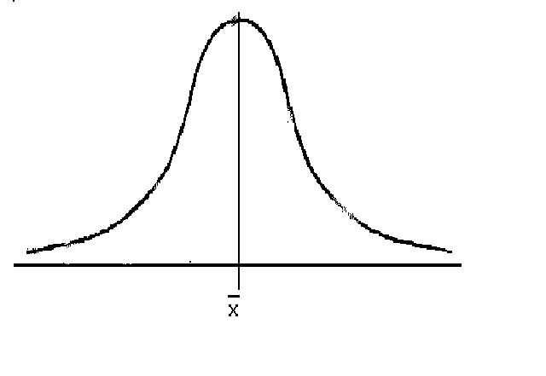
Word comprehension test scores:
Person with no brain damage: no. correct: mean = 92, SD = 6 out of 100
Brain-damaged person: no. correct: 89 out of 100.
Is this person's comprehension significantly impaired?
Step 1: Graph the problem:
?
Step 2: Convert 89 into a z-score:
z = (89 - 92) / 6 = - 3 / 6 = - 0.5
89
92

Slide 74
Step 3: use the table to find the "area beyond z" for our z of - 0.5:
?
Area beyond z = 0.3085
89
92
Conclusion: .31 (31%) of people without brain damage are likely to have a comprehension score this low or lower.

Slide 75
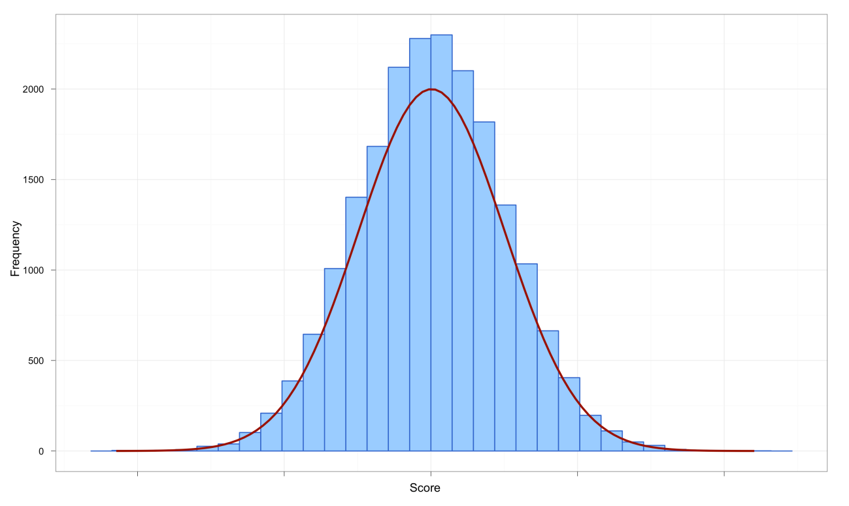
The Normal Distribution
The curve shows the idealized shape.
It is important that our data is close to this shape if we wish to use Parametric tests.

Slide 76
The Normal Distribution
Normal Curve or Bell-shaped Curve
Key players: Abraham DeMoivre (1667-1754) and Carl Frederick Gauss (1777-1855)
Sometimes normal distribution is referred to as a Gaussian distribution
Smooth, symmetrical curve about the mean which is the highest point of the curve
Approaches the horizontal axis but never touches it (asymptotic)
The spread of the curve is determined by the standard deviation
Larger this value the more spread out the curve is, smaller the more peaked it is
The inflection points where it starts to transition are determined by the mean +/- one standard deviation
The area under the curve is 1

Slide 77
Normal Distribution
A density curve describes the overall pattern of a distribution.
Formula used to generate the shape of the curve is the normal density function
A distribution is normal if its density curve is symmetric, single-peaked and bell-shaped.
Mean, Median, and mode are same for a normal distribution.

Slide 78
Properties of the Normal Distribution:
1. It is bell-shaped and asymptotic at the extremes.

Slide 79
2. It's symmetrical around the mean.

Slide 80
3. The mean, median and mode all have same value.

Slide 81
4. It can be specified completely, once mean and SD are known.

Slide 82
5. The area under the curve is directly proportional to the relative frequency of observations.
Thus we can calculate the probability of observations occurring in a population

Slide 83
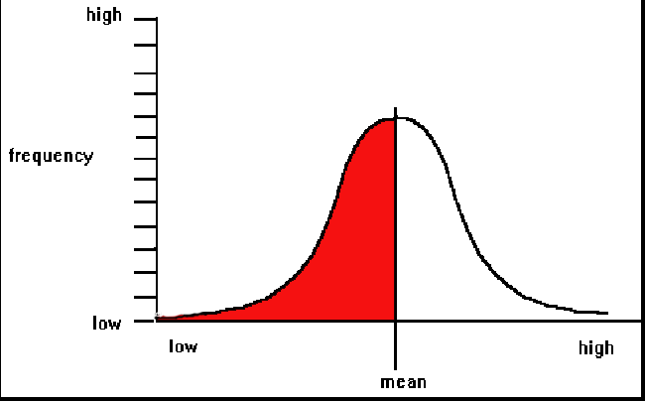
e.g. here, 50% of scores fall below the mean, as does 50% of the area under the curve.

Slide 84
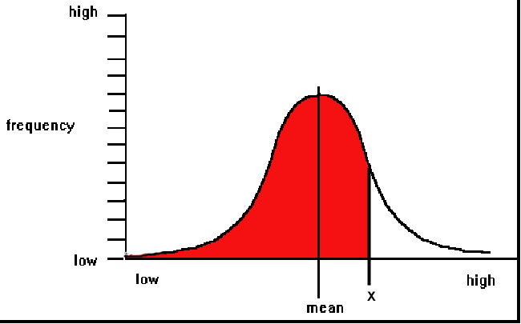
e.g. here, 85% of scores fall below score X, corresponding to 85% of the area under the curve.

Slide 85
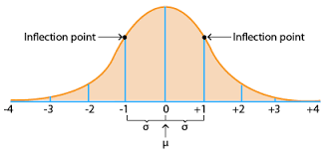
Normal Distribution
If we know µ and σ, we derive a lot of additional information about the data with a normal distribution.

Slide 86
Normal Distribution
The Empirical Rule - The 68-95-99.7 Rule
In the normal distribution with mean µ and standard deviation σ:
68% of the observations fall within σ of the mean µ.
95% of the observations fall within 2σ of the mean µ.
99.7% of the observations fall within 3σ of the mean µ.

Slide 87
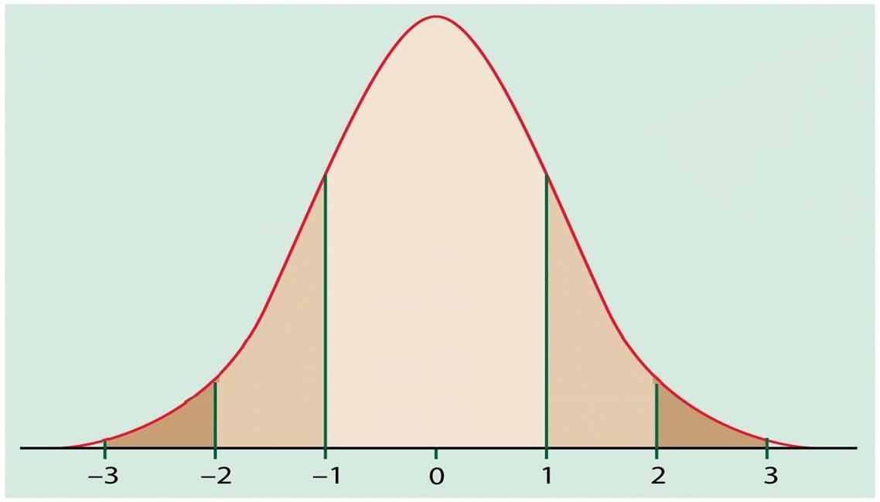

Slide 89
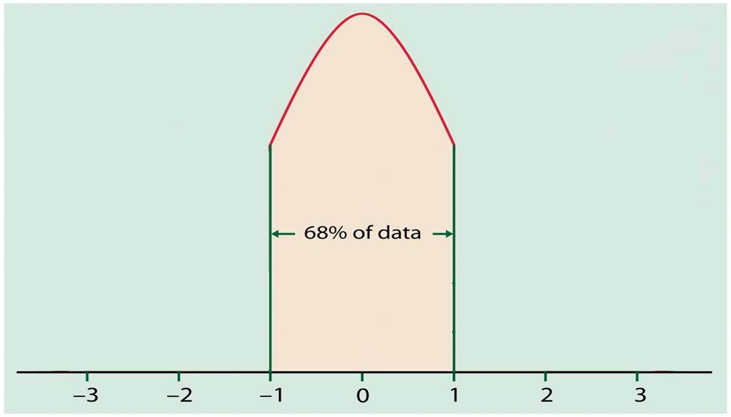

Slide 91
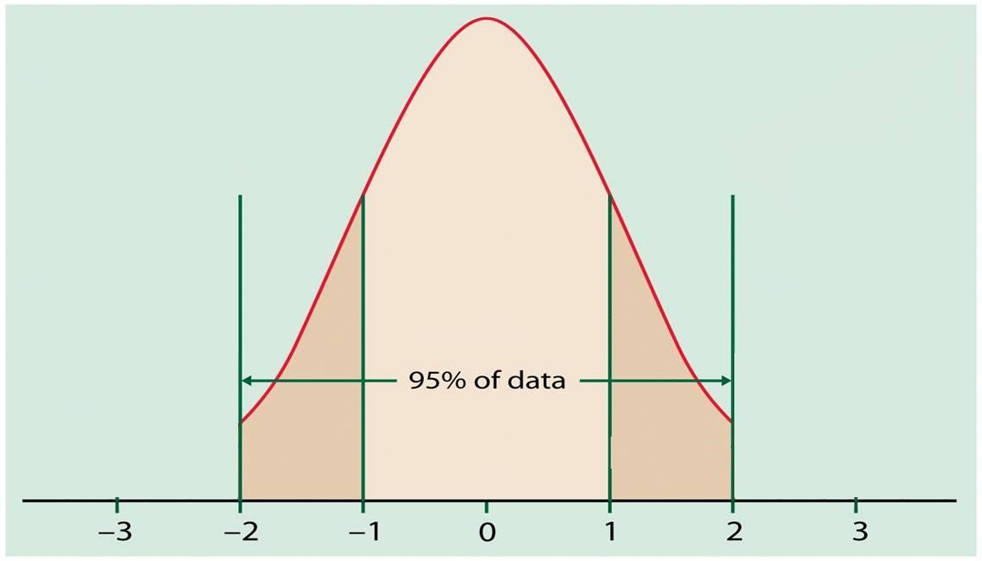

Slide 93
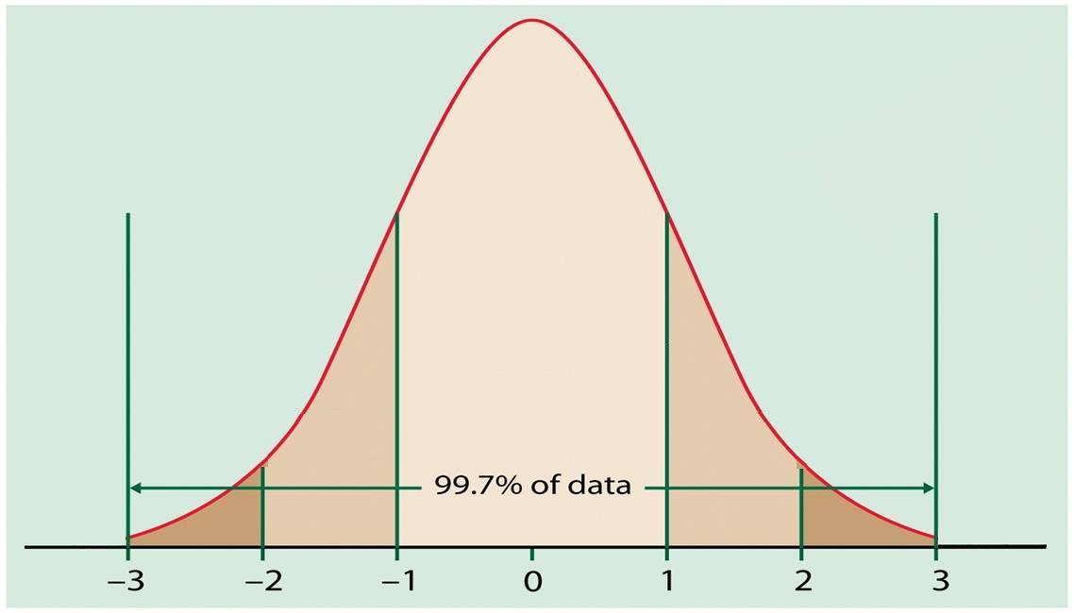

Slide 95
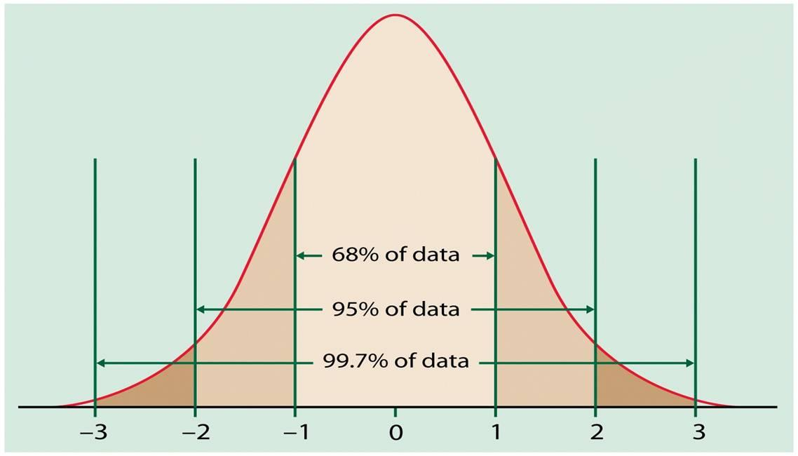

Slide 96
The Normal Distribution
If a variable is normally distributed, then:
within one standard deviation of the mean there will be approximately 68% of the data
within two standard deviations of the mean there will be approximately 95% of the data
within three standard deviations of the mean there will be approximately 99.7% of the data

Slide 97
Properties of z-scores
1.96 cuts off the top 2.5% of the distribution.
−1.96 cuts off the bottom 2.5% of the distribution.
As such, 95% of z-scores lie between −1.96 and 1.96.
99% of z-scores lie between −2.58 and 2.58,
99.9% of them lie between −3.29 and 3.29.

Slide 98
Normal Distribution in summary
Many psychological/biological properties are normally distributed.
This is very important for statistical inference (extrapolating from samples to populations)
z-scores provide a way of
(a) comparing scores on different raw-score scales;
(b) showing how a given score stands in relation to the overall set of scores.
(c) using probability tables to calculate likelihood of particular scores.

Slide 99
Normal distribution in summary
The logic of z-scores underlies many statistical tests:
1. Scores are normally distributed around their mean.
2. Sample means are normally distributed around the population mean.
3. Differences between sample means are normally distributed around zero ("no difference").
We can exploit these phenomena in devising tests to help us decide whether or not an observed difference between sample means is due to chance.

Slide 100
Distribution is central to choosing the correct test
Parametric Tests
Normal distribution
Non-parametric Tests
Non normal distribution
Always start by looking at the data!

Slide 101
The Research Process

Slide 102
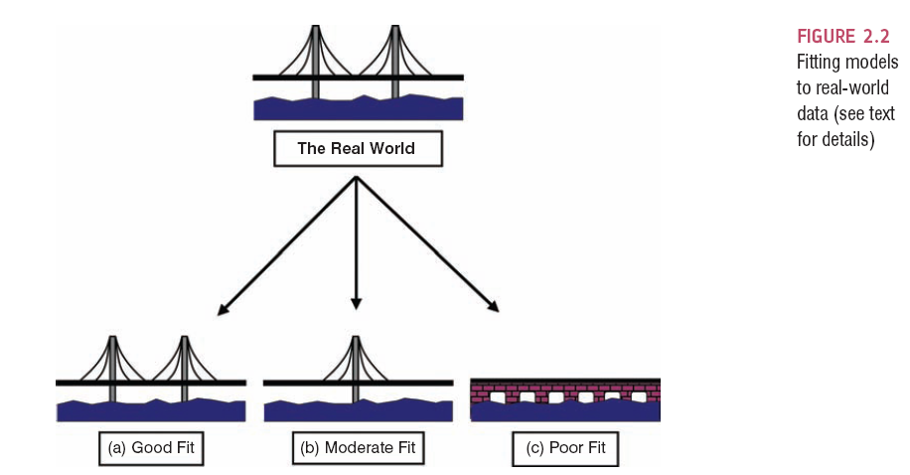
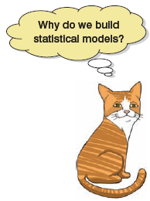

Slide 103
Populations and Samples
Population
The collection of units (be they people, plankton, plants, cities, suicidal authors, etc.) to which we want to generalize a set of findings or a statistical model
Sample
A smaller (but hopefully representative) collection of units from a population used to determine truths about that population

Slide 104
The Only Equation You Will Ever Need

Slide 105
A Simple Statistical Model
In statistics we fit models to our data (i.e. we use a statistical model to represent what is happening in the real world).
The mean is a hypothetical value (i.e. it doesn’t have to be a value that actually exists in the data set).
As such, the mean is simple statistical model.
Notes:
One of the simplest models we use in statistics is the mean. Some of you may have trouble thinking of the mean as a model, but in fact it is because it represents a summary of data. The mean is a hypothetical value that can be calculated for any data set, it doesn’t have to be a value that is actually observed in the data set. For example, if we took five statistics lecturers and measured the number of friends that they had, we might find the following data: 1, 3, 4, 3, 2. If we take the mean number of friends, this can be calculated by adding the values we obtained, and dividing by the number of values measured:. Now, we know that it is impossible to have 2.6 friends (unless you chop someone up with a chainsaw and befriend part of their remains, which in practice has proved disturbing) so the mean value is a hypothetical value. As such, the mean is a model that we create to summarise our data.

Slide 106
The Mean
The mean is the sum of all scores divided by the number of scores.
The mean is also the value from which the (squared) scores deviate least (it has the least error).

Slide 107
Measuring the ‘Fit’ of the Model
The mean is a model of what happens in the real world: the typical score.
It is not a perfect representation of the data.
How can we assess how well the mean represents reality?

Slide 108
Calculating ‘Error’
A deviation is the difference between the mean and an actual data point.
Deviations can be calculated by taking each score and subtracting the mean from it:

Slide 109
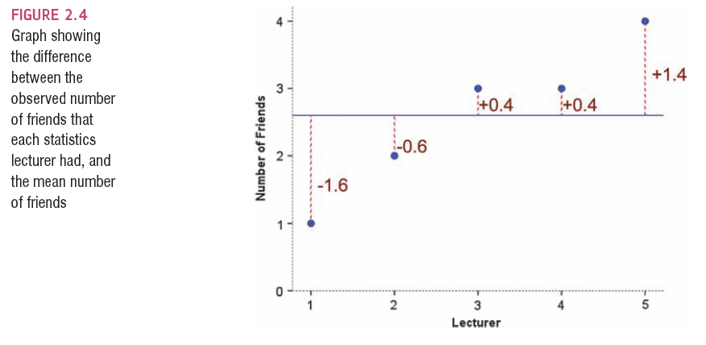

Slide 110
Use the Total Error?
We could just take the error between the mean and the data and add them.
Score | Mean | Deviation
1 | 2.6 | -1.6
2 | 2.6 | -0.6
3 | 2.6 | 0.4
3 | 2.6 | 0.4
4 | 2.6 | 1.4
 | Total = | 0

Slide 111
Sum of Squared Errors
We could add the deviations to find out the total error.
Deviations cancel out because some are positive and others negative.
Therefore, we square each deviation.
If we add these squared deviations we get the sum of squared errors (SS).

Slide 112
Score | Mean | Deviation | Squared Deviation
1 | 2.6 | -1.6 | 2.56
2 | 2.6 | -0.6 | 0.36
3 | 2.6 | 0.4 | 0.16
3 | 2.6 | 0.4 | 0.16
4 | 2.6 | 1.4 | 1.96
 |  | Total | 5.20

Slide 113

Variance
The sum of squares is a good measure of overall variability, but is dependent on the number of scores.
We calculate the average variability by dividing by the number of scores (n).
This value is called the variance (s2).

Slide 114
Standard Deviation
The variance has one problem: it is measured in units squared.
This isn’t a very meaningful metric so we take the square root value (measured in units).
This is the standard deviation (s).

Slide 115
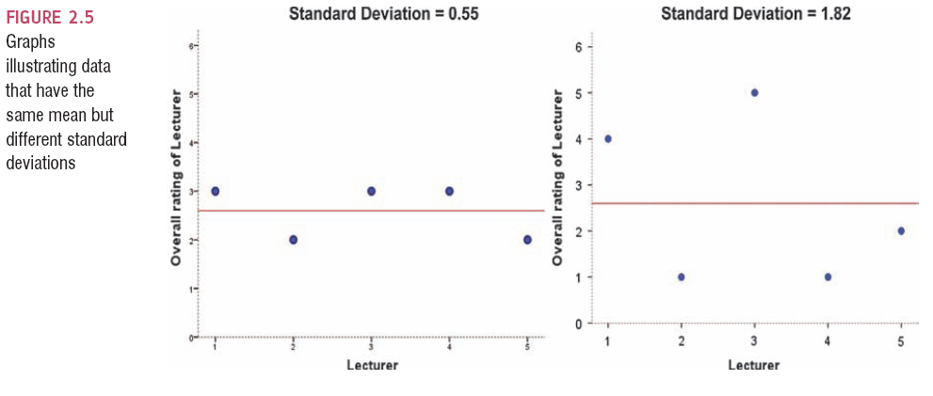
Same Mean, Different SD

Slide 116
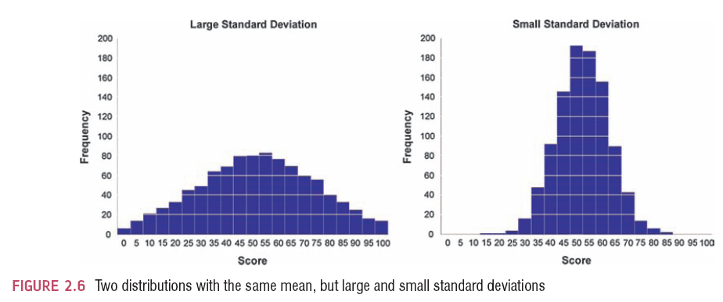
The SD and the Shape of a Distribution

Slide 117
So what is the mean a model of?
We have used it to model a summary of a set of data
The standard deviation in this case represents how good a ‘fit’ that model is to the set of data
So we are assessing the fit of the model by comparing the data we have to the model we’ve ‘fittted’ to the data
This is a fundamental idea within the linear statistical model

Slide 118
Important Things to Remember
The sum of squares, variance, and standard deviation represent the same thing:
The ‘fit’ of the mean to the data
The variability in the data
How well the mean represents the observed data
Error

Slide 119
Samples vs. Populations
Sample
Mean and SD describe only the sample from which they were calculated.
Population
Mean and SD are intended to describe the entire population (very rare in most studies).
Sample to Population:
Mean and SD are obtained from a sample, but are used to estimate the mean and SD of the population (very common).

Slide 120
Going beyond the data
We now know how to fit a simple model to our data
But usually we want to move beyond our data to the wider world the data represents and say something about the world
Based on our sample
So we need to look at whether is model is a good fit for the population from which it came

Slide 121
Going beyond the data
We ideally want to collect data from all members of the population
We usually collect a number of samples
Each sample could have a different mean - sampling variation
We can plot the sample means into a frequency distribution
Sample distribution

Slide 122
Going beyond the data
So what?
If we have enough samples we can calculate the population mean
But how well does it fit ?
Need to calculate the standard deviation of the sample means
Standard error of the mean (SE)

Slide 123
Sampling Variation

Slide 124
Population
μ = 10
M = 10
M = 9
M = 11
M = 10
M = 9
M = 8
M = 12
M = 10
M = 11

Slide 125
Going beyond the data
In reality we can’t collect enough samples
Instead we rely on an approximation of the sample mean and sample error
Based on the Central Limit Theorem
As samples get large, the sampling distribution has a normal distribution with a sample mean equal to the population mean and a standard deviation of

Slide 126
So what does this mean?
We can use the standard deviation of the sampling distribution as the approximation of the sample error
If our distribution follows the normal distribution
For other shapes of distribution we have other ways of approximating the population mean and standard error.

Slide 127
Confidence Intervals
CI represents a range of values between which we think a population value will fall
Suppose we are looking at our fish in Lough Mask
True mean
15 thousand fish
Sample mean
17 thousand fish
Interval estimate
12 to 22 thousand(contains true value)
16 to 18 thousand (misses true value)
CIs constructed such that 95% contain the true value.

Slide 128
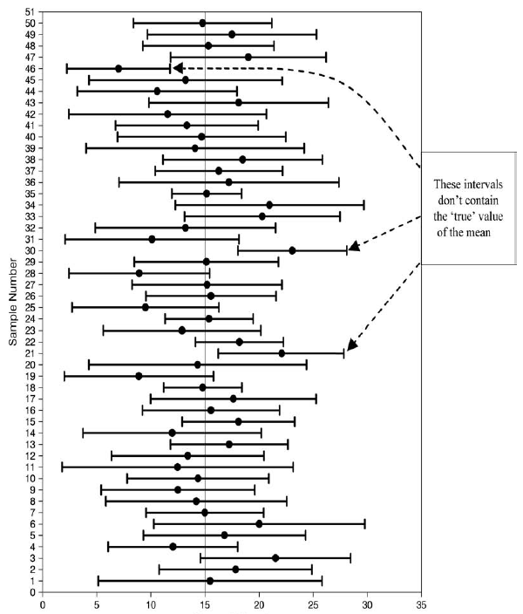
Fish Numbers(thousands)

Slide 129
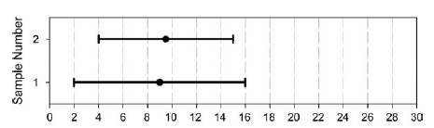
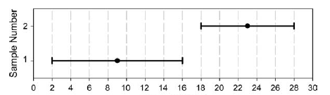
Fish Numbers(thousands)
Fish Numbers(thousands)

Slide 130
How to construct a CI?
Typically look at 95% CI but can also look at 99%
What does this mean?
If we say CI is 95% then if we collected 100 samples, calculated the mean
Then a CI of 95% means we are confident that 95 of these would contain the true mean
How to calculate?
Need to know the limits within which 95% of the means fall
Go back to the normal distribution – 95% of scores fall between +-1.96
Once we know the mean and standard deviation we can calculate any score and therefore the CI

Slide 131
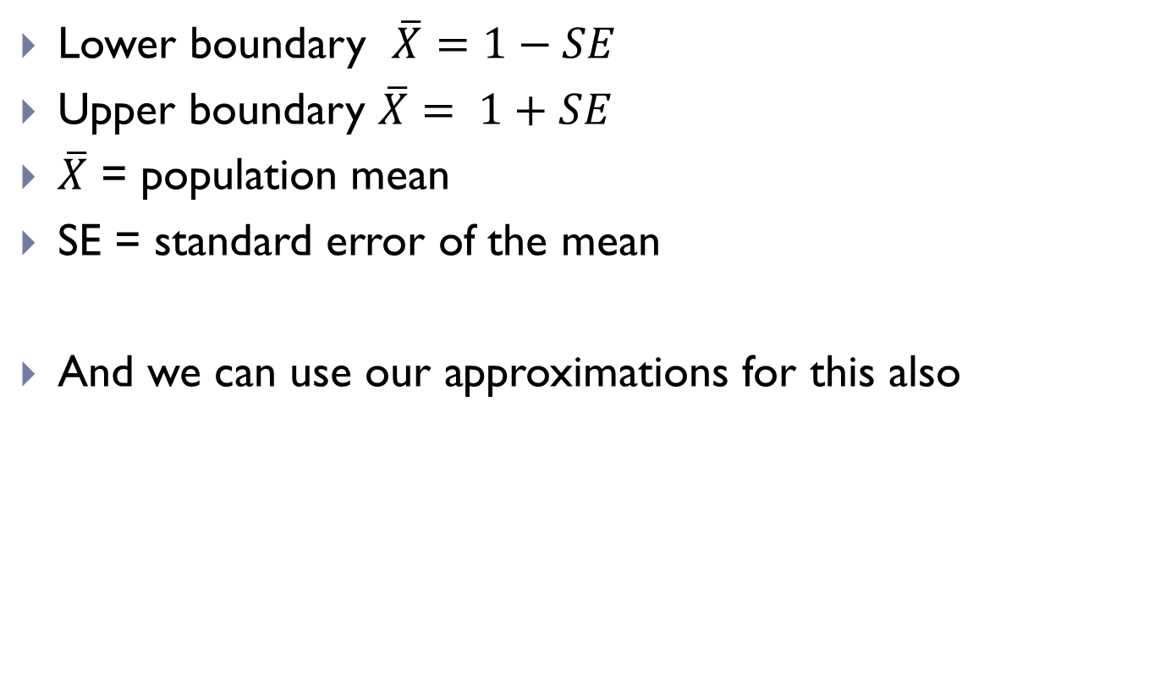
CI
Lower boundary $\overline{X}=1−SE$
Upper boundary $\overline{X}= 1+SE$
$\overline{X}$ = population mean
SE = standard error of the mean
And we can use our approximations for this also

Slide 132
The Art of Presenting Data
Graphs should (Tufte, 2001):
Show the data.
Induce the reader to think about the data being presented (rather than some other aspect of the graph).
Avoid distorting the data.
Present many numbers with minimum ink.
Make large data sets (assuming you have one) coherent.
Encourage the reader to compare different pieces of data.
Reveal data.
Tufte(2001) Edward Tufte, The Visual Display of Quantitative Information, Graphics Press, 2nd edition,2001

Slide 133
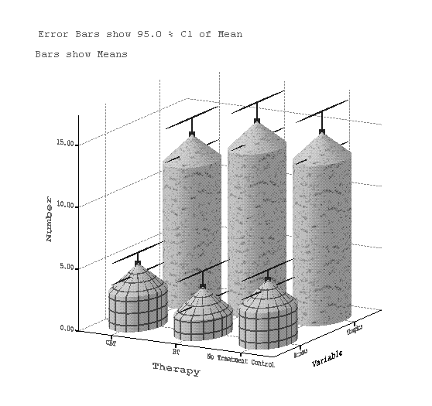
Why Is This Graph Bad?

Slide 134
Why Is This Graph Better?

Slide 135
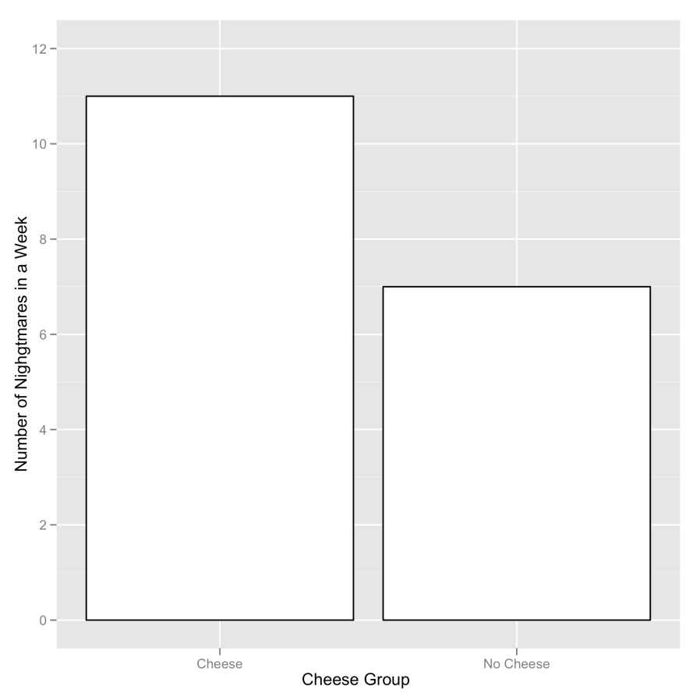
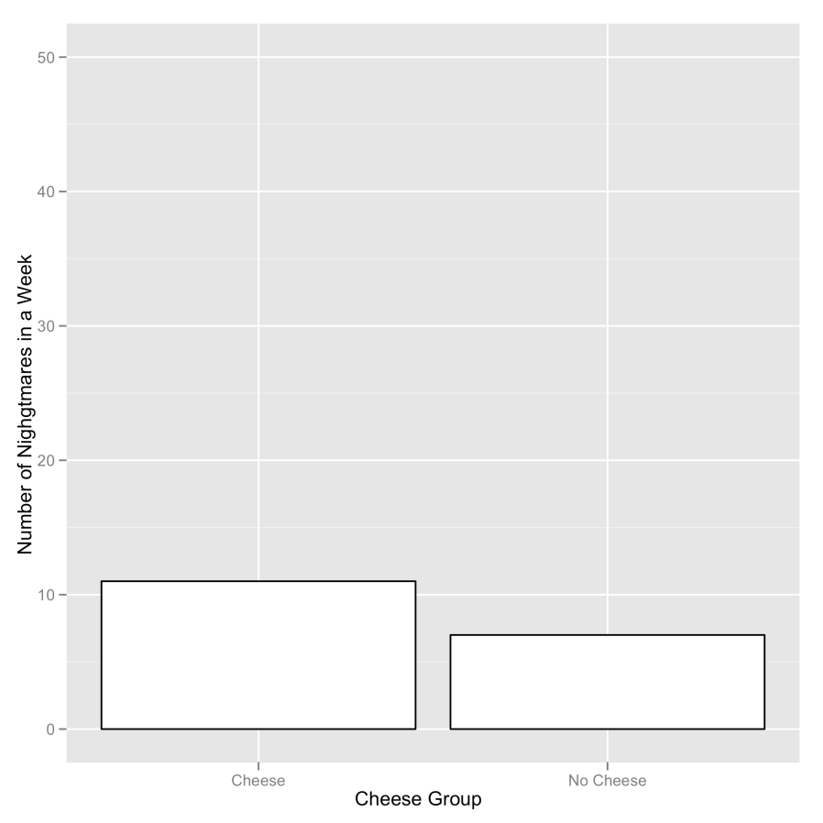
Be Careful with your scales
Two graphs about cheese

Slide 136
Graphical Presentation
Nominal or Ordinal:
Bar charts, Pie charts or Frequency Tables
Interval or Ratio numerical:
Histogram, Stem and Leaf diagrams or Box-plot
Depending on dispersion
KEY SLIDE

Slide 137
Stem-and-Leaf plot
Shows data arranged by place value.
You can use a stem-and-leaf plot when you want to display data in an organized way that allows you to see each value.
Use for small to moderate sized data sets.
Doesn’t work well for large data sets.
Accompany with a comment on the centre, spread, and shape of the distribution and if there are any unusual features.

Slide 138
Creating Stem-and-Leaf Plots
Use the data in the table to make a stem-and-leaf plot.
Test Scores
75 | 86 | 83 | 91 | 94
88 | 84 | 99 | 79 | 86
Step 1: Group the data by tens digits.
75 79
83 84 86 86 88
Step 2: Order the data from least to greatest.
91 94 99

Slide 139
Creating Stem-and-Leaf Plots
Step 3: List the tens digits of the data in order from least to greatest. Write these in the “stems” column.
75 79
83 84 86 86 88
91 94 99
Step 4: For each tens digit, record the ones digits of each data value in order from least to greatest. Write these in the “leaves” column.
Test Scores
Stems
Leaves
Step 5: Title the graph and add a key.
7
5 9
8
3 4 6 6 8
Key: 7 5 means 75
9
1 4 9

Slide 140
Reading Stem-and-Leaf Plots
Find the least value, greatest value, mean, median, mode, and range of the data.
The least stem and least leaf give the least value, 40.
Stems
Leaves
4
0 0 1 5 7
The greatest stem and greatest leaf give the greatest value, 94.
5
1 1 2 4
6
3 3 3 5 9 9
7
0 4 4
8
3 6 7
Use the data values to find the mean (40 + … + 94) ÷ 23 = 64.
9
1 4
Key: 4 0 means 40

Slide 141
Reading Stem-and-Leaf Plot
The median is the middle value in the table, 63.
To find the mode, look for the number that occurs most often in a row of leaves. Then identify its stem. The mode is 63.
Stems
Leaves
4
0 0 1 5 7
5
1 1 2 4
6
3 3 3 5 9 9
7
0 4 4
The range is the difference between the greatest and the least value. 94 – 40 = 54.
8
3 6 7
9
1 4
Key: 4 0 means 40

Slide 142
Histograms
When to Use
Univariate (single variable) numerical data
Discrete data
May only take on a finite number of values or countable number of values
Draw a horizontal scale and mark it with the possible values for the variable
Draw a vertical scale and mark it with frequency or relative frequency
Above each possible value, draw a rectangle centred at that value with a height corresponding to its frequency or relative frequency
To describe
Comment on the centre, spread, and shape of the distribution and if there are any unusual features
For comparative histograms – use two separate graphs with the same scale on the horizontal axis
Constructed differently for discrete versus continuous data

Slide 143
Queen honey bees mate shortly after they become adults. During a mating flight, the queen usually takes several partners, collecting sperm that she will store and use throughout the rest of her life. A study on honey bees provided the following data on the number of partners for 30 queen bees.
12 2 4 6 6 7 8 7 8 11 8 3 5 6 7 10 1 9 7 6 9 7 5 4 7 4 6 7 8 10
Create a histogram for the number of partners of the queen bees.

Slide 144
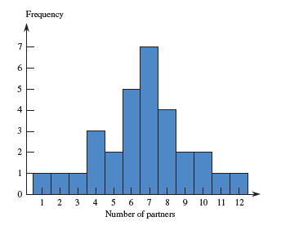
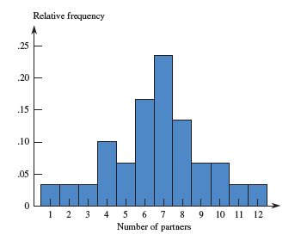
Draw a rectangle above each value with a height corresponding to the frequency.
First draw a horizontal axis, scaled with the possible values of the variable of interest.
Next draw a vertical axis, scaled with frequency or relative frequency.
Suppose we use relative frequency instead of frequency on the vertical axis.

Slide 145
Histograms
When to Use
Univariate numerical data (one variable)
Continuous data
Mark the boundaries of the class intervals on the horizontal axis
Draw a vertical scale and mark it with frequency or relative frequency
Draw a rectangle directly above each class interval with a height corresponding to its frequency or relative frequency
To describe
Comment on the centre spread, and shape of the distribution and if there are any unusual features
This is the type of histogram that most people are familiar with.

Slide 146
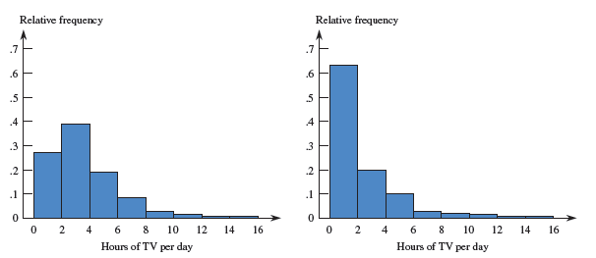
A study examined the length of hours spent watching TV per day for a sample of children age 1 and for a sample of children age 3. Below are comparative histograms.
Notice the common scale on the horizontal axis
Write a few sentences comparing the distributions.
The median number of hours spent watching TV per day was greater for the 1-year-olds than for the 3-year-olds. The distribution for the 3-year-olds was more strongly skewed right than the distribution for the 1-year-olds, but the two distributions had similar ranges.
Children Age 1
Children Age 3
Notes:
See pages 124-125.

Slide 147
Frequency Distribution
Graphs are useful in assisting us in assessing the distribution in a set of data for a particular variable
Frequency distribution shows the relative frequencies of values for variables of interest in a dataset
Where values have been binned into groups (e.g. 10 to 20, 21 to 30 etc)
The height of each bar is proportional to the relative frequency in the data set of the group it represents.
Normal distribution
Bell-shaped, scores equally distributed around a central value (mean)
Skewed
Lack of symmetry
Data pulled towards one end of the graph
Kurtosis
Pointyness

Slide 148
Plots in R

Slide 149
ggplot2
In ggplot2 a plot is made up of layers.

Slide 150
A graph is made up of a series of layers
Each layer can be made up of different visual elements - geoms
The anatomy of a graph

Slide 151
Geometric Objects(geoms)
geom_bar(): creates a layer with bars
geom_point(): creates a layer with data points
geom_line(): creates a layer with lines
Geom_histogram(): creates a layer with a histogram
geom_boxplot(): creates a layer with a box-whisker diagram
geom_text(): creates a layer with text on it
geom_density(): creates a layer with a density plot on it

Slide 152
Geometric Object functions
Each takes different parameters.
See handout for pages from Andy Field re properties associated with common geom + some common aesthetics

Slide 153
Using ggplot()
Create an object that specifies the plot
Pass in the data and set whatever aesthetics you want to apply to all layers (if any)
Adjust the layers
Display/save the graph

Slide 154
Examples
PSIWeek2.R
Details of the datasets used are also provided.

